Slide 1



AI Controlled Smart Room

Slide 2
Presented by
NAME ID
MIAH, MD.BADHON 18-38225-2
ISLAM, MD.MINHAJUL 17-34048-1
KAZI ABU SAAD 17-35077-2
S.M.SAYEEM RAHMAN 17-33729-1
TOTINI,SUMAYA,BINTE NASIR 18-38180-2
MD, SHAHORIAR ALIF UTSHO 18-38055-2
UDDIN, DEWAN FAHIM 18-38049-2
SAHA, ATANU 18-38429-2

Slide 3

WHAT IS ‘SMART ROOM!’
Smart room technology intelligently gives us ultimate control over our room by automating the electrical appliances inside the room to increase energy efficiency.
Smart room connect all the devices and appliances in a room so they can communicate with each other and with you.

Slide 4
Main PURPOSE
To get rid of from irregular lighting.
To keep oneself away from excessive noise.
To maintain a normal temperature.
To detect air condition and notifying with suggestion.

Slide 5
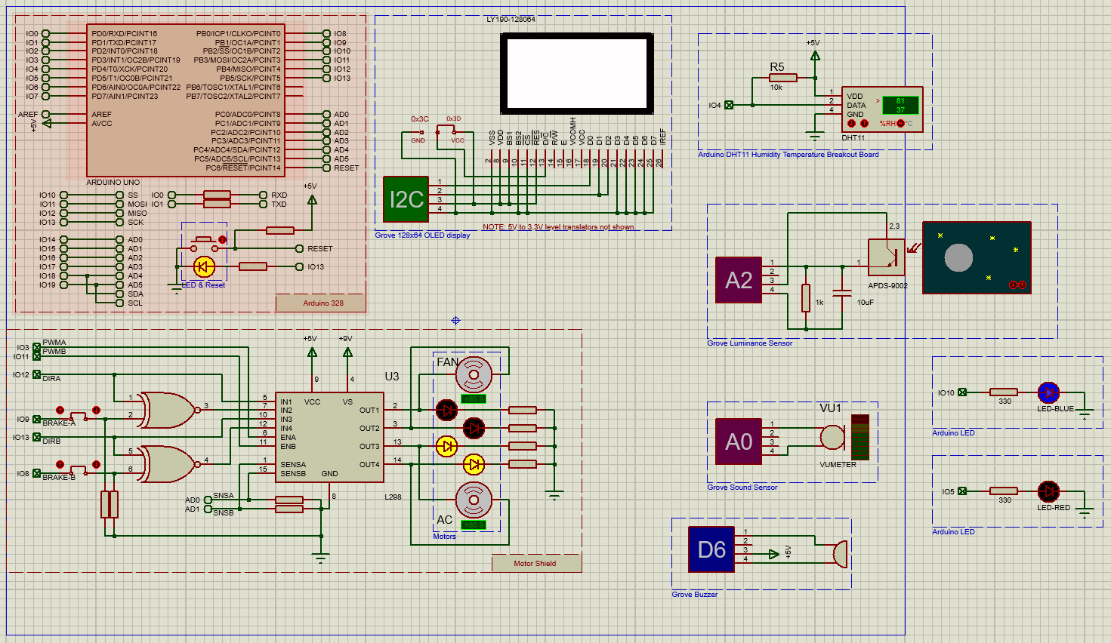
Circuit design

Slide 6
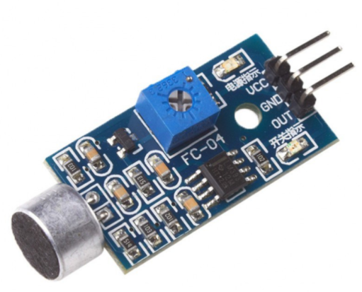
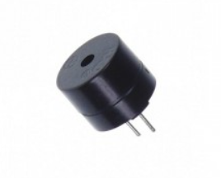
Component Details
Sound Sensor:
Detects the intensity of sound and coverts into electric signal
Consist of microphone, peak detector and amplifier
capable to determine noise levels within decibels at 3 kHz 6 kHz frequencies
Luminance Sensor:
Luminance Sensor detects the intensity of the ambient light on a surface area
Converts light energy into electricity
It is used for brightness control of light depending on day/night
Sound Sensor
Buzzer:
Used for signaling high intensity of sound around the place
It makes sound through vibration
Buzzer

Slide 7
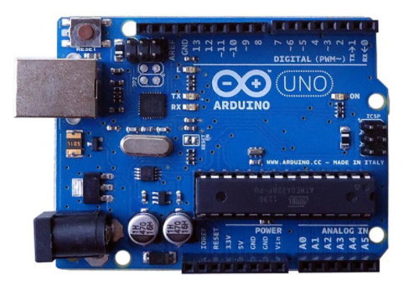
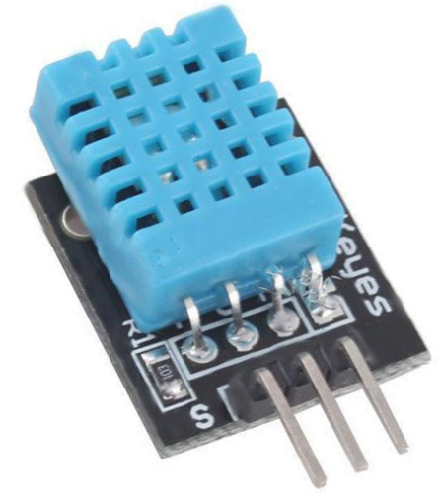
Component Details
Arduino UNO:
An electronics platform based on easy-to-use hardware and software
Capable of reads inputs from light sensors, gas sensors, temperature sensors etc.
Control the board by sending set of instructions.
Arduino UNO
DHT11:
Used instead of gas sensor
Detects Temperature and Gas Density(actually measures Humidity)
It will help to determine when the AC or Fan will be turned on/off
DHT11
DC motor:
Two DC moto were used to control the speed of Fan and also for AC
Works by turning electricity into motion
One is for running the AC and another is for running the Fan

Slide 8
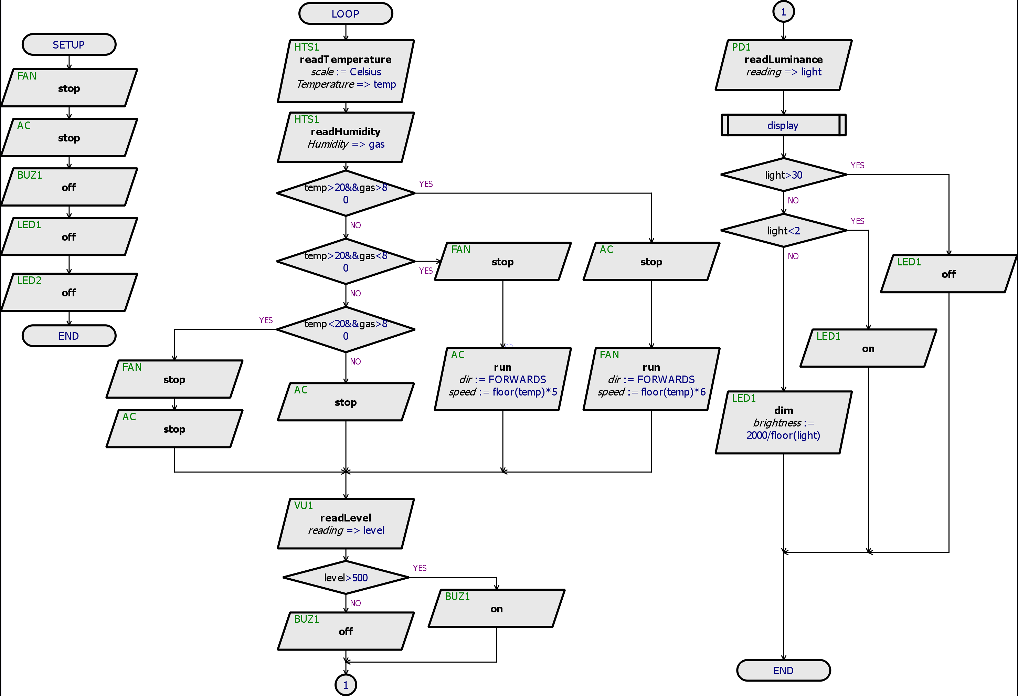
Project workflow

Slide 9
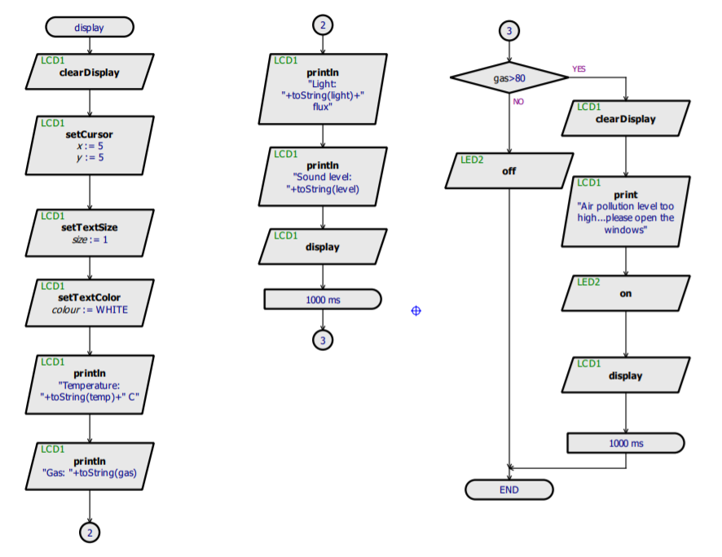
Project workflow

Slide 10
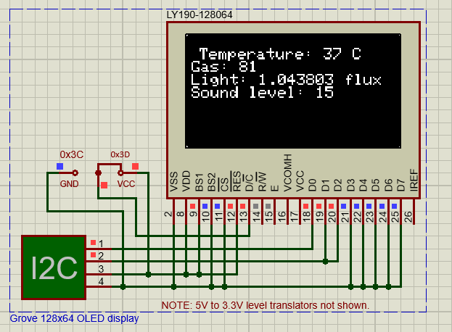
result

Slide 11
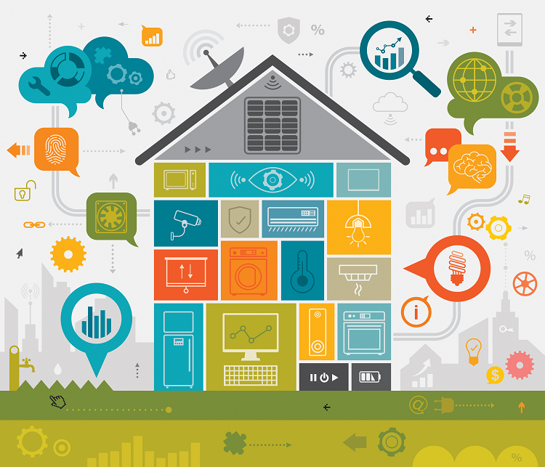
Environmental impact
This is an environment friendly device which is suitable and beneficial for the betterment of humankind.
This device is saving electricity which is a big impact in our country.
Rather than impacting the environment, this device senses the environment and gives feedback to the users.

Slide 12
Project finance
The cost of a smart room greatly depend on how “ SMART” you really want it

Slide 13
ADVANTAGES
Energy efficient.
Hands-free & convenience.
Enhanced life security.
Save time with automated tasks.
Easy to use
Cost efficient.

Slide 14
DISADVANTAGES
Configuration is moderate. Need expert technician.
Maintenance is complex and costly.
Unsuitable placement of this device can cause system failure.
Damage of sensor(s) can provide faulty result which might be harmful for users.

Slide 15
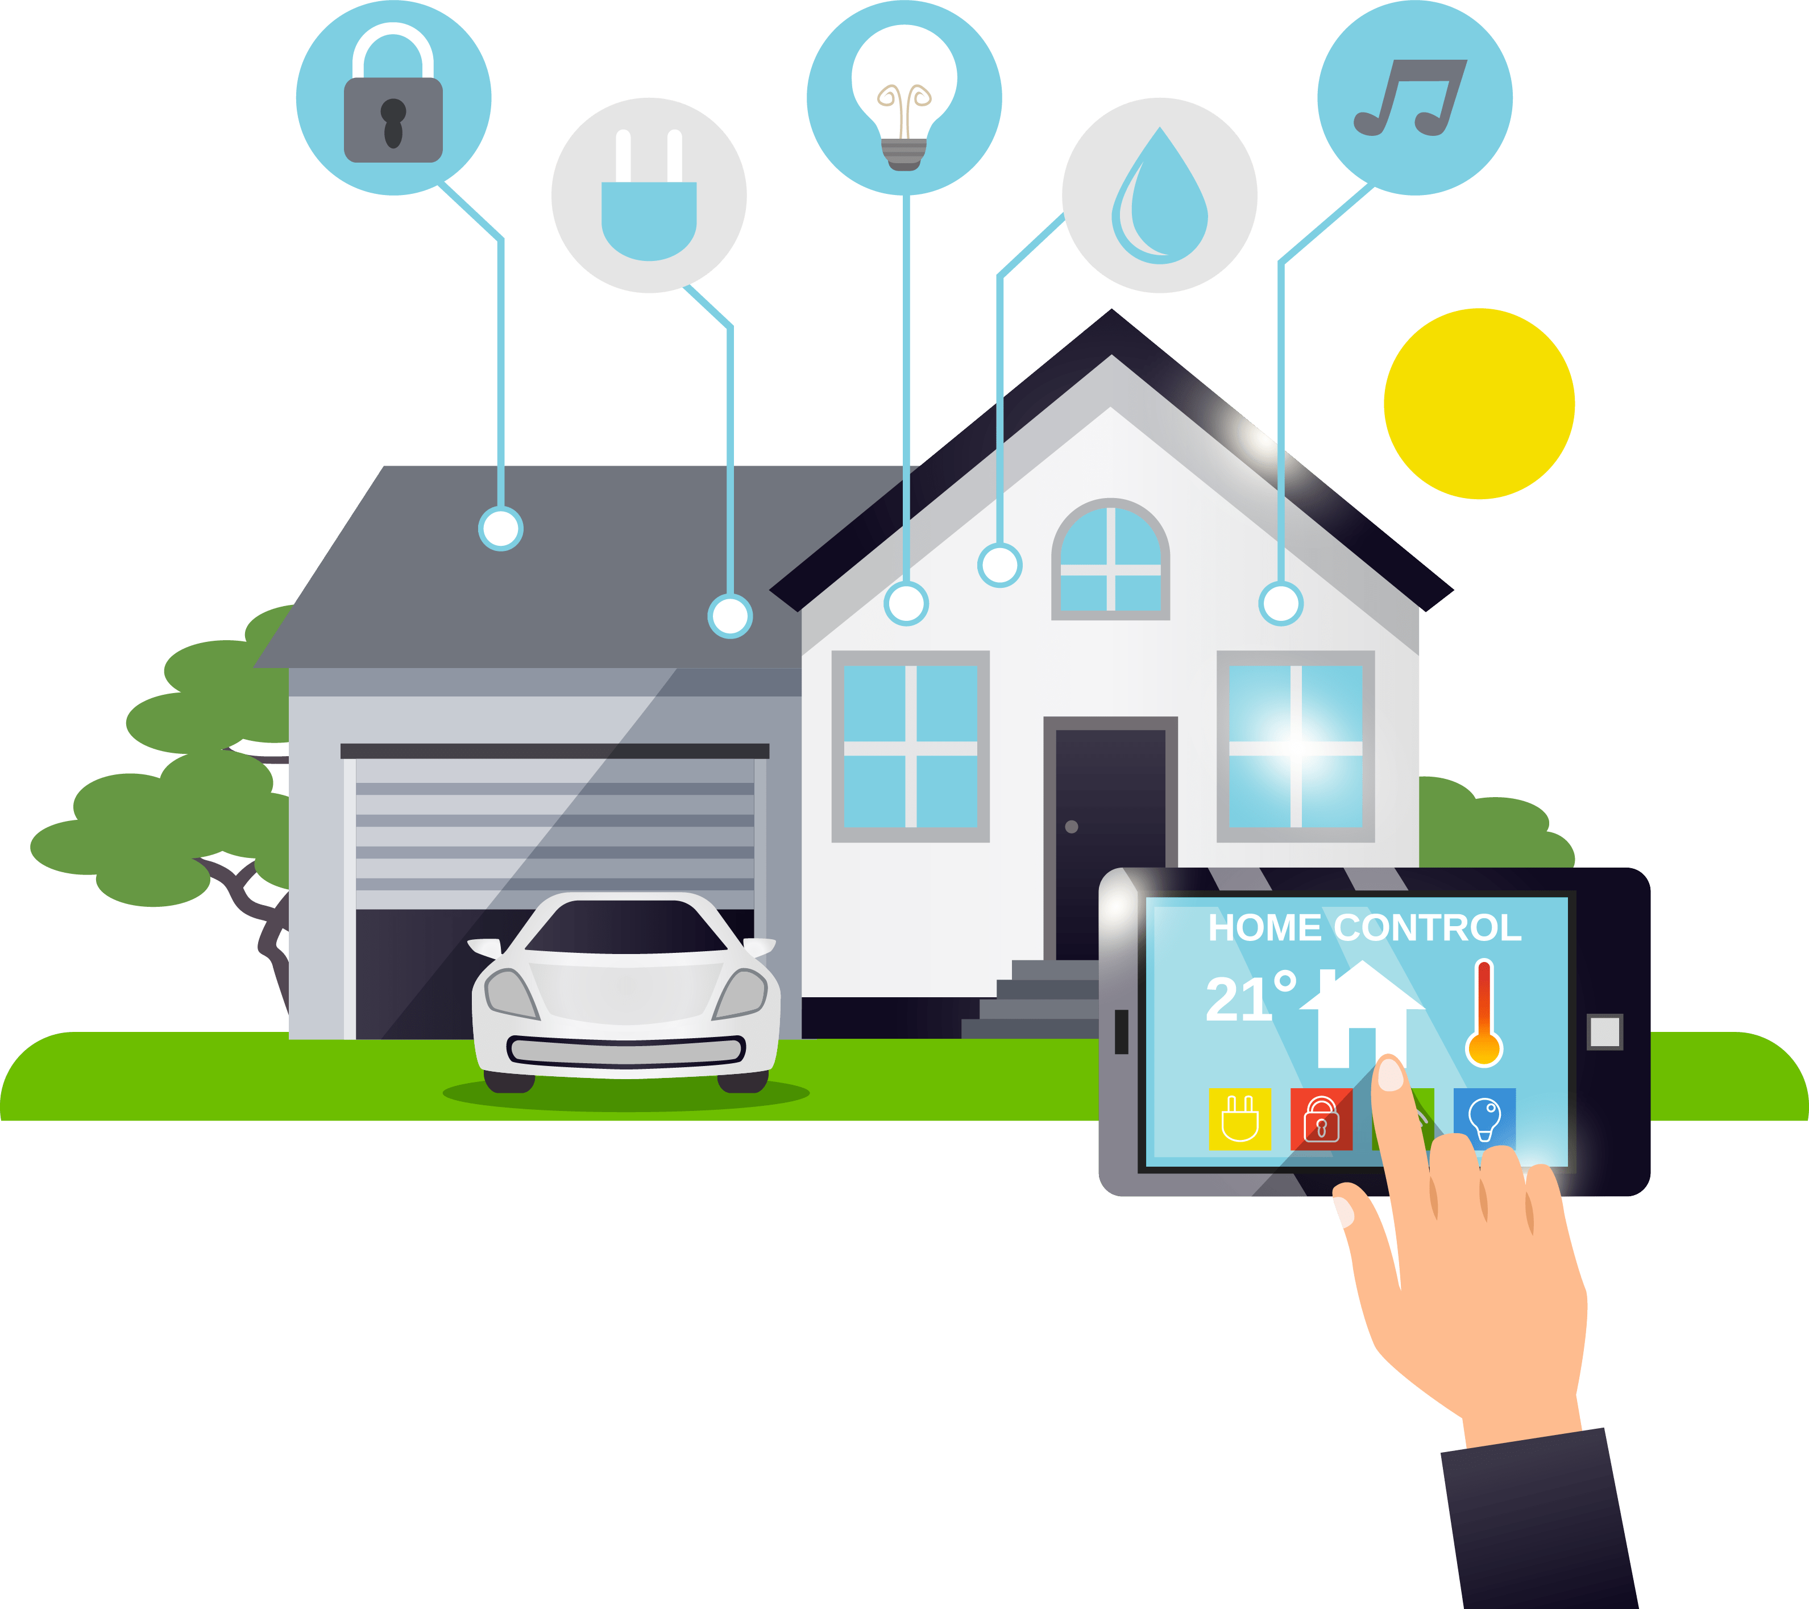
Life Saving Technology
The air quality detection sensor used here can detect the presence of harmful gas inside the room. If the inhabitants living in the room take necessary steps when they get alarmed with our system, they can save themselves from a disaster.

Slide 16
Conclusion
Keeping in mind that technology is rapidly changing, we can use modern technology for the betterment of our life and for that AI controlled Smart Room is a great choice. As this device is energy and cost efficient, it will be very much helpful for Bangladeshi people to take them into next stage of technological life. Many country can provide similar type of features with a higher cost whereas our device is providing all these features with lower cost. In a nutshell, we believe and say that AI controlled Smart Room is a must component for the future human kind.

Slide 17

Questions
&
Answers

Slide 18


